Slide 1

RFID BASED SALARY CALCULATOR
GUIDE:
Dr Shweta Pandit
PRESENTED BY:
Saloni Sharma - 191003
Shalini Siddhi -191047

Slide 2


CONTENT:
Introduction
Scope of the project
Literature review
Overall block diagram
Procedure
Work flow diagram
Project Timeline using Gantt chart
9. References
8. Conclusion

Slide 3


Introduction
This project is about a smart salary calculator based on RFID tag scanning. The concept is implemented by calculating the daily working hours of the employee and storing it to the central database and generating the salary accordingly.
In order to ensure that the calculated working hours are valid another RFID is used at main entrance to detect the number of taps by the specific RFID tag.

Slide 4
2. Scope of the project
The main objective of this project is to reduce the effort of administrator to keep the daily events such as payroll, employee performance, and employees details which enhances the productivity of the organization both in terms of manpower and time,all with minimal human interaction.

Slide 5
3. Literature review
[1] Navaneeth S., Megha P.M., Sruji N. M., Anusha T. R.and Haritha S.
“Students Smart Card using RFID” , International Research Journal of Engineering and Technology (IRJET)
Volume: 05 Issue: 04 | Apr-2018
In this paper , we studied about smart card based on RFID for student's attendance. RFID tag is used to carry student's details and RFID reader to read the details , the microcontroller will check for the authenticity and then the student's details will be displayed on the screen.The student smart card avoids moving from one access point to other ( i.e., multi point) during their registration and can be accessed from single point.
[2] G D P Maramis and P T D Rompas
»Radio Frequency Identification (RFID) Based Employee Attendance Management System”, IOP Conf. Series: Materials Science and Engineering 306 (2018)
While recording the attendance manually we face problems such as data accuracy and performance efficiency to overcome this problem in this research paper we studied about designing and developing a software of RFID attendance system which is integrated with database system . The ID cards will be replaced by RFID tags and reader device which will read the information of the employees. This system has a maximum reading range of 2 cm with success probability of 1 and requires a minimum interval between readings of 2 seconds in order to achieve an optimal functionality.

Slide 6
In this proposed project we are using the same concept of RFID attendance system that is integrated with the database and has a function to store the data or information of every single employee using several main components such as tags that will be used as a replacement of ID cards and a reader device that will read the information related to the employee attendance but the agenda is to calculate the working hours based on taps by the tag indicating in/out time of the particular employee.
The calculated working hours will help the system to calculate salary based on his/her designation in the organization.
Even/odd no of taps at the main gate detected by another RFID scanner will ensure that the employee is not skipping his/her work after entering his in time at the entrance gate.

Slide 7
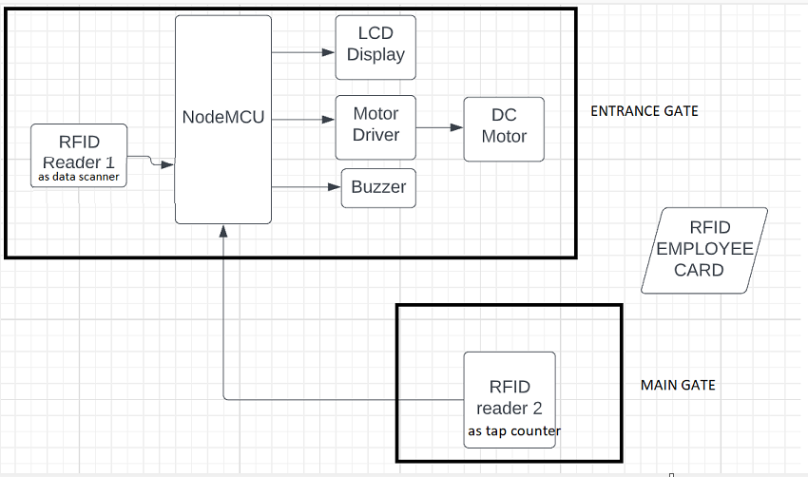
4. Overall block diagram

Slide 8
5. Procedure
1
2
3
4
A tag has a microchip with a special unique number, which is stored in the RFID memory, that is useful in identifying
In order to ensure that the calculated working hours are valid another RFID reader 2 is used at main gate to detect the number of taps by tag. Odd no of taps will lead to buzzer sound indicating that the employee is not entering valid in time through his/her tag.
A tag has a microchip with a special unique number, which is stored in the RFID memory, that is useful in identifying employee’s data individually. An RFID reader is a special device that take a role to interrogate the tags.
If the number of the tag is found in the database, then the system will save the employee id and the name and also the in/out time into the backend database and display it on LCD connected to node MCU.
Working hours of an employee is found by the system using the in and out time stored in the central database read by RFID reader 1 at entrance gate and his/her salary is calculated as per his designation in the organization.

Slide 9
6. Work flow diagram
No
start
No
start
yes
yes
RFID Detected
RFID Detected
yes
yes
Registered employee
No
Input Employee
Even number of taps
No
Invalid working hours indicated by buzzer
yes
yes
Record the time and display the information
Valid working hours calculated
ENTRANCE GATE
MAIN GATE

Slide 10
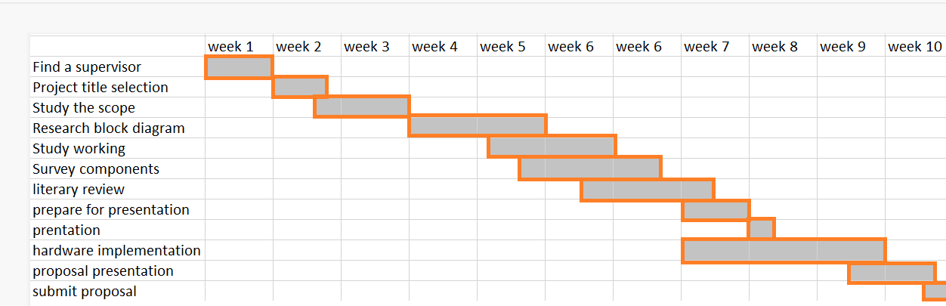
7. Project timeline using Gantt chart
Duration in weeks
s.No
1
2
3
4
5
6
7
8
9
10
11
12
Activities

Slide 11
8. Conclusion
The existence of databases in data storage facilitate the search data so that it can help the institution or company to improve the effectiveness in performing data absenteeism of employees.
It offers an ease way in recapitulation of employee attendance data for payroll purposes.
The system overall increases the efficiency of reporting and evaluating the performance of the employee and the discipline of the employee itself.

Slide 12
9. References
https://iopscience.iop.org/article/10.1088/1757-899X/306/1/012045/pdf
https://www.irjet.net/archives/V5/i4/IRJET-V5I4249.pdf
https://www.slideshare.net/bharath405/rfid-based-smart-card-reader

Slide 13
THANK
YOU.

